Slide 1

Gesture Recognition With WIFI Sensing
A Machine Learning Approach to Classifying Hand Gestures with CSI Data
Venkata Reddy Aditya Singh Parmar dharani goalla
prof : Dr. Honggang wang
Yeshiva University Capstone 2024
GitHub Link

Slide 2
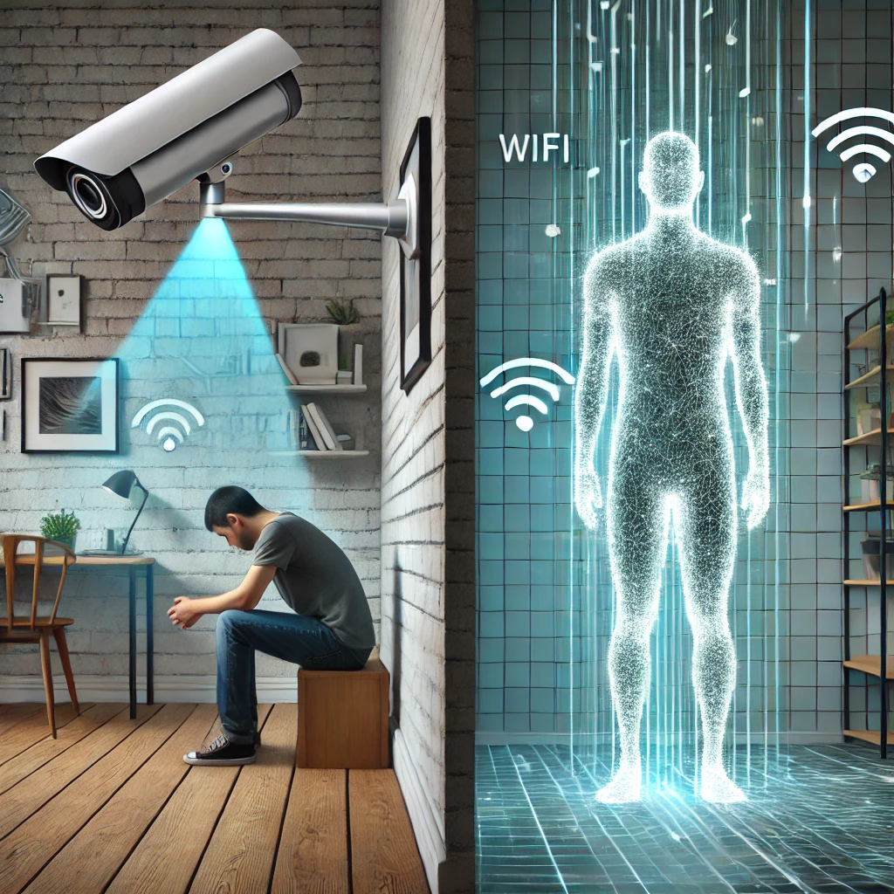
Objective: Reducing Privacy Intrusion with WiFi Sensing
Problem Statement : Inhouse Camera
Indoor cameras raise privacy concerns in personal spaces.
Intrusiveness and discomfort from constant video recording.
High costs and maintenance challenges.
Solution: WiFi Sensing
Privacy-Friendly: No video or image capture, ensuring user comfort.
Unobtrusive: Uses existing WiFi infrastructure, no additional hardware.
Cost-Efficient: Affordable setup with minimal maintenance.
ESP32 can be baught under 10USD, can also give home automation.

Slide 3
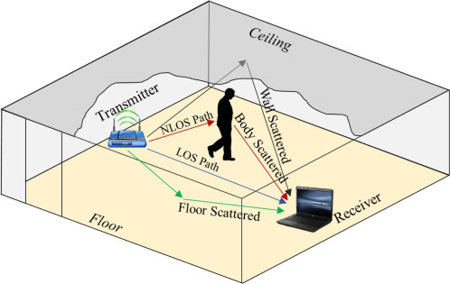
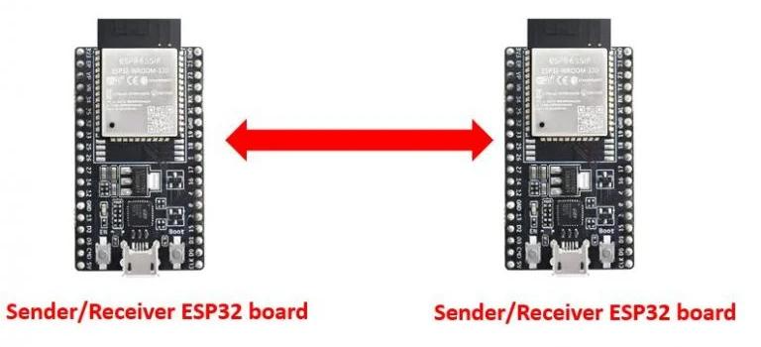
Wifi Sensing using ESP32
Sample CSI Data:
The sample CSI data is collected at 100 samples per second from a CSI receiver.
The data includes 384 subcarriers, representing different frequencies in the wireless signal.
Types of Subcarriers:
1. HTLTF (High Throughput Long Training Field) Subcarriers
2. SBLTF (Short Training Field) Subcarriers
3. TLTF (Training Field) Subcarriers
Granular Movement Detection:
HTLTF subcarriers are specifically used for granular movement detection, as they provide detailed signal information.
For this purpose, we use the range of subcarriers:
66 to 94 (inclusive)
95 to 123 (inclusive)
These 58 HTLTF subcarriers are crucial for detecting fine-grained gestures or movements.

Slide 4
Introduction
Workflow:
1. Collect and preprocess CSI data.
2. Train models and check for improvements.
3. Visualize data to diagnose and resolve issues.
4. Apply advanced preprocessing and clustering techniques to improve accuracy
Tools Used:
Languages: Python
Libraries: Pandas, Scikit-Learn, TensorFlow/Keras, Matplotlib

Slide 5
Data Collection
CSI Data Collection:📡
Captured CSI data via a serial connection from Wi-Fi devices.
Utilized tools to log data in real-time - ESP32
Instance Grouping:
Grouped data into instances of 300 samples per gesture.
Each instance represents a complete gesture movement.
Gestures Collected:✋
Circle, Sitting Still, Swipe and Clap.
Challenges:⚠️
Noisy Data: Interference from the environment affected data quality.
Inconsistent Formatting: Data sometimes logged with missing or incorrect entries.

Slide 6
Initial Preprocessing
Data Cleaning:🧹
Removed unnecessary columns to streamline the dataset..
Added appropriate headers for clarity and consistency
Feature Extraction:📊
Extracted HT-LTF amplitude and phase features to capture signal variations..
Standardization:⚙️
Ensured data format consistency across all samples.
Goal:🎯
Prepare the dataset for effective model training by making it clean, structured, and informative.

Slide 7
Transforming Data for CNN
Normalization: 📉
Scaled amplitude and phase data to a 0-1 range for consistency
Reshaping for CNN:🔄
Formatted data to fit CNN input dimensions
Shape: (num_samples, num_subcarriers, time_steps, Label)
Label Encoding: 🔢
Converted class labels to one-hot encoded vectors for multi-class classification.
CNN Architecture:🧠
Convolutional Layers: Feature extraction from input data.
Pooling Layers: Down-sample and reduce complexity.
Batch Normalization: Stabilizes and accelerates training.

Slide 8
Initial CNN Model Results
Training Accuracy: ✅
Achieved a high accuracy of 95% during training
Testing Accuracy:📉
Testing accuracy was significantly lower at 54%, indicating poor generalization
Issues Identified: ⚠️
Overfitting: The model performed well on training data but failed to generalize to new data
Lack of Robustness: The model struggled with unseen variations in the test set
Key Insight and Next Steps Required:
Further preprocessing, better feature extraction, and exploring alternative models were necessary.

Slide 9
Data Visualization to Diagnose Issues
Techniques Used:
PCA (Principal Component Analysis): Reduces dimensions while preserving variance.
t-SNE (t-Distributed Stochastic Neighbor Embedding): Captures local relationships and clusters.
LDA (Linear Discriminant Analysis): Maximizes class separability.
Key Findings:
PCA and t-SNE: Showed overlapping clusters between gestures.
LDA: Provided better separation of gesture classes.
CNN Architecture:
Overlapping data indicated the need for better preprocessing.
Clearer clusters with LDA suggested improvements were possible.

Slide 10
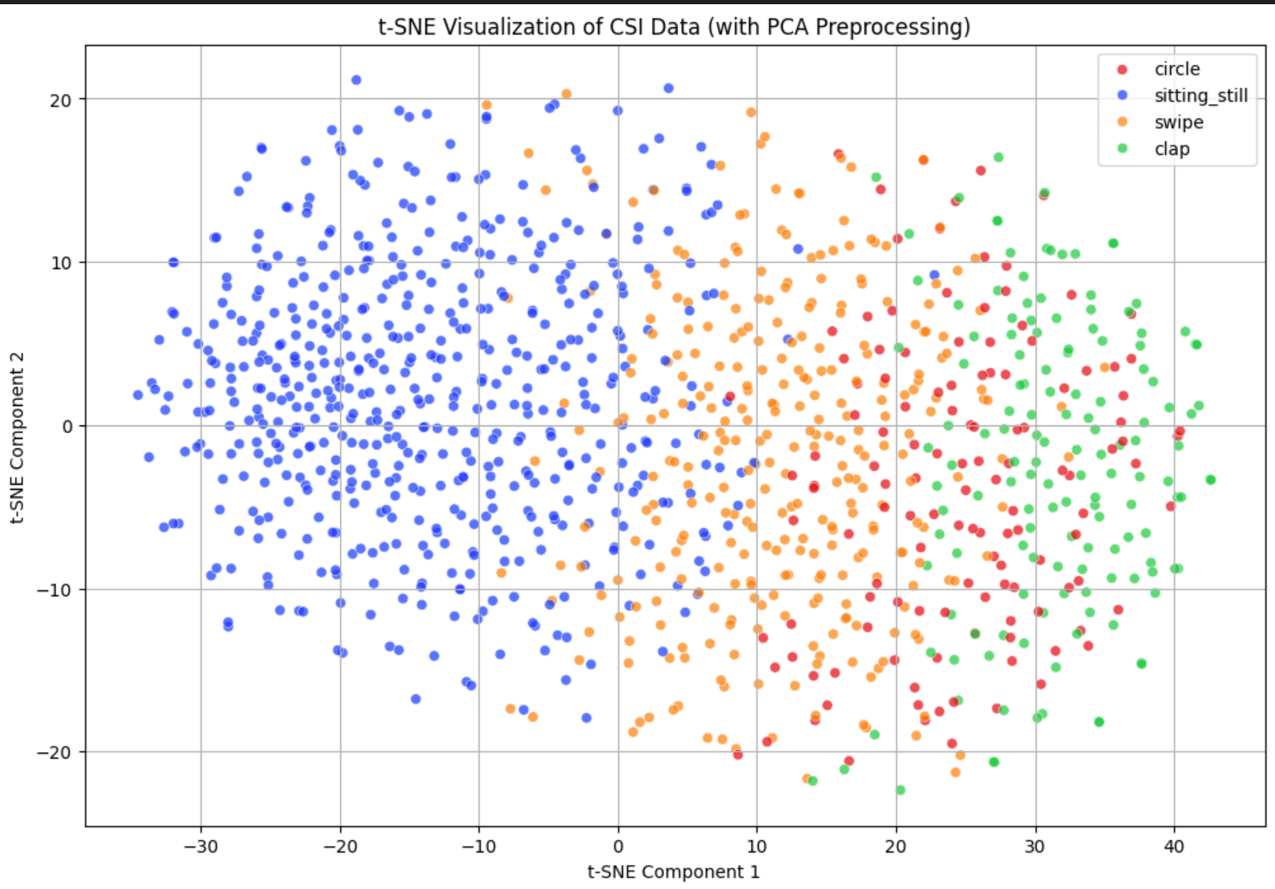
Data Visualization to Diagnose Issues

Slide 11
Advanced Preprocessing
Noise Reduction:
Applied Moving Average Filtering and Median Filtering to reduce environmental interference.
Feature Standardization:
Ensured uniform data format across all samples.
Enhanced Feature Extraction:
Refined HT-LTF amplitude and phase features.
Computed CSI Ratios to capture relationships between subcarriers.
Added derived features like phase differences and amplitude ratios.
Dimensionality Reduction:
Applied LDA (Linear Discriminant Analysis) for supervised feature reduction.
Used K-Means Clustering to enhance class separability.

Slide 12
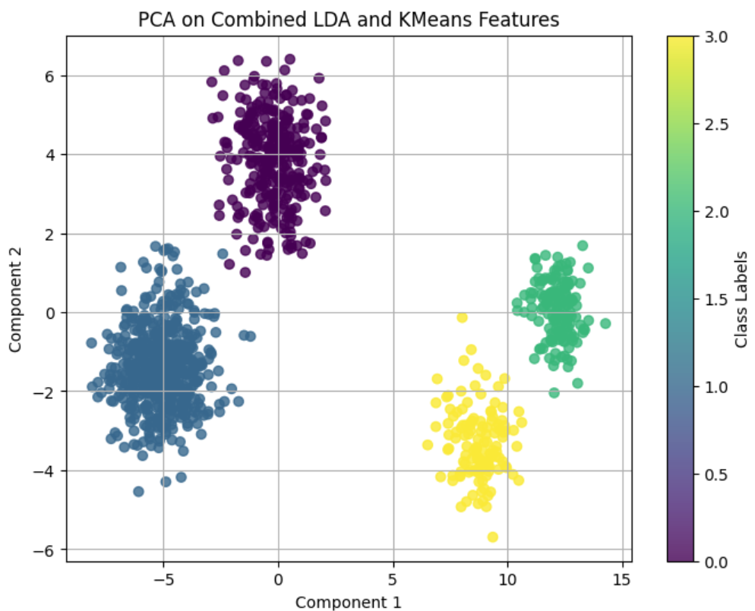
Results of Advance data Processing
Improved Data Quality:
Cleaner, more structured data after applying filtering and standardization.
Enhanced Feature Separation:
Better cluster separation observed in visualizations.
Techniques Visualized:
PCA: Reduced dimensionality with visible overlaps.
t-SNE: Showed local clusters but still had overlaps.
LDA + K-Means: Clearly defined clusters with improved separability

Slide 13
Model Experiments and Results
CNN:
Training Accuracy: 95%
Testing Accuracy: 54% (Overfitting).
Random Forest: Testing Accuracy: 82%.
Decision Tree: Testing Accuracy: 78%.
Logistic Regression: Testing Accuracy: 85%.
KNN: Testing Accuracy: 80%.
SVM(BEST MODEL):
Training Accuracy: 94.24%
Testing Accuracy: 93.81%
Cross-Validation Accuracy: 94.23%

Slide 14
Conclusion and Future Work
Explore Advanced Models:
Implement LSTM (Long Short-Term Memory) and Transformers to capture temporal patterns and improve accuracy.
Increase Data Diversity:
Collect more data with a wider variety of gestures and different environments to improve robustness.
Real-Time Implementation:
Develop a real-time gesture recognition system for practical.
Feature Optimization:
Experiment with additional feature extraction techniques to further enhance data quality.

Slide 15
Challenges and Lessons Learned
Challenges Faced:
Noise in CSI Data: Environmental interference affected data quality.
Overlapping Gesture Clusters: Difficulties distinguishing between similar gestures.
Overfitting in CNN: High training accuracy but poor generalization to test data..
Solutions Implemented:
Applied Moving Average and Median Filtering to reduce noise.
Used LDA and KMeans Clustering to improve class separability.
Tried multiple models and identified SVM for better generalization.
Key Lessons Learned:
Preprocessing Matters: Effective preprocessing significantly impacts model performance.
Visualization Helps: Visualizing data can reveal issues that need attention.
Model Selection: Different models have strengths and weaknesses; experimentation is key.

Slide 16
Q&A / Thank You
Questions?
Thank you for your attention!

